Slide 1
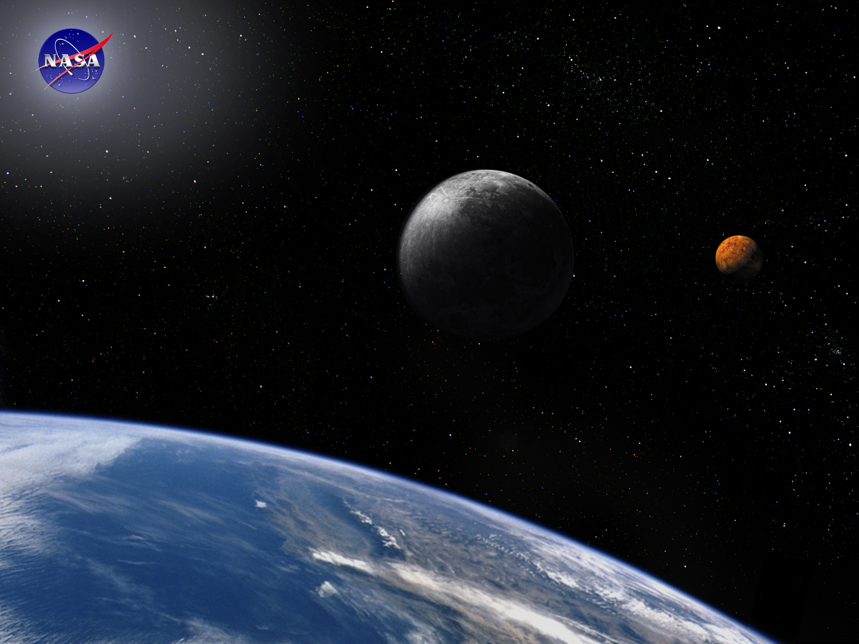
Course Overview Module
Space Systems Engineering, version 1.0
Notes:
Version 1.0
SOURCE INFORMATION:
The material contained in this lecture was developed by Lisa Guerra of NASA’s Exploration Systems Mission Directorate while on assignment in the Department of Aerospace Engineering at the University of Texas at Austin. As part of a course entitled, Space Systems Engineering, the lecture was piloted at UT-Austin in Spring 2008.
The content that follows was also reviewed and edited by Dr. Paul Graf, Adjunct Professor at the University of Colorado at Boulder.

Slide 2
Not trying to make everyone who takes the course a systems engineer, but trying to give aerospace engineers a systems perspective.
Course Goal
Notes:
Since this course was developed for aerospace engineers, that discipline term is used here. You can replace with other discipline or simply with undergraduate engineers.
The intent here is to emphasize that every engineer will most likely encounter some aspect of systems engineering in their careers, even though they never aspire to be labeled a systems engineer.

Slide 3
Space Systems Engineering Course Overview
NASA is motivated to have universities add Systems Engineering to undergraduate curriculum requirements.
This course uses a space theme, but is applicable to engineering disciplines other than aerospace.
This course is designed as a pre-requisite to the senior capstone design class. Many of the systems engineering tools and techniques are necessary for good system design.
This course was developed and piloted at The University of Texas at Austin in the Department of Aerospace Engineering, 2008.
Introductions
  Instructor; Teaching Assistant
  Students, including their SE experience
Review of Syllabus & Schedule (handouts)
Grade - homework, exams, projects, readings
Access to materials
Notes:
Example Syllabus (Pilot_SE_Course_Syllabus_2008.doc) and Schedule (Pilot_SE_Course_Schedule_2008.xls) are provided with this course overview lecture file.
These are the syllabus and schedule used for the pilot class, Space Systems Engineering, taught at UT-Austin in Spring 2008.
They provide an example of the sequence of work, the use of class time, and the approach to grading.

Slide 4
Semester-long Reading Assignment (1/2)
Intent: to further understand aspects of systems engineering through professional literature.
Select one book from list:
An Introduction to General Systems Thinking, Gerald M. Weinberg
Design Paradigms: Case Histories of Error and Judgment in Engineering, Henry Petroski (or alternative Petroski selection)
The Secret of Apollo, Stephen B. Johnson
Against the Gods: The Remarkable Story of Risk, Peter L. Bernstein
The Machine that Changed the World, J. Womack, D. Jones & D. Roos
Space Systems Failures, D. Harland The Columbia Accident Investigation Board Report, Volume 1, 2003
Note: All books available on Amazon.com
Notes:
These are books used for the pilot Space Systems Engineering class.
Only one student read the Weinberg book; and determined that it is geared toward a graduate student level.
You may also want to solicit the students to add to the list. One student from the pilot class chose: “Systems Approach to Engineering Design”, by P. H. Sydenham
Overall the exercise was very positive. Many of the students said they would tried to read all the selections during their summer break. If anything, the exercise instilled in them a sense of reading professional literature about engineering.
Note: Additional file (Semester_Reading_Assignment.doc) can be used for students to sign-up for their book selection.

Slide 5
Semester-long Reading Assignment (2/2)
Write a 5-7 page book report on the relevancy of the book to systems engineering.
Questions to address in report:
  What are the main points that the book is trying to get across from an engineer’s perspective?
  How is the book relevant to learning/practicing systems engineering?
  Were there any concepts in the book that should be included in the curriculum?
  Did the author(s) do a good job explaining particular topics?
  Did you learn anything?
  Did you enjoy the book?
  Take-away: what will you remember most from reading this book?
At end of semester:
  Turn in individual book report.
  Conduct book discussion with your fellow readers.
  Produce a consolidated list of pros and cons for including the book in the systems engineering curriculum.
Notes:
Originally the assignment was 10 pages long, but many of the students provided feedback regarding shortening the report length.

Slide 6
Alternative Semester-long Assignment (1/2)
Intent: to learn systems engineering lessons from previous space mission mishaps.
Select one failure report from list:
  WIRE Mishap Investigation Board Report June 8, 1999
  Genesis
  CONTOUR Comet Nucleus Tour Mishap Investigation Board Report; May 31, 2003
  The Hubble Space Telescope Optical Systems Failure Report; November 1990
  The NEAR Rendezvous Burn Anomaly of December 1998; November 1999
  SOHO Mission Interruption; Joint NASA/ESA Investigation Board Final Report; August 31, 1998
  Beagle 2 Independent Review Report; September 29, 2000
  Report on the Loss of the Mars Polar Lander and Deep Space 2 Missions; JPL Special Review Board; 22 March 2000
  Mars Observer Mission Failure Investigation Board Report; December 31, 1993
  Mars Climate Orbiter Mishap Investigation Board Report; November 10, 1999
  Lewis Spacecraft Mission Failure Investigation Board final report; February 12, 1998
Note: All failure reports available from the instructor.
Notes:
This is an option to the book report assignment used in the pilot Space Systems Engineering class.
The assignment is very space oriented, in that all the failure reports apply to space missions.
Note that Challenger and Columbia accident reports are not included here, since they are very daunting in comparison to the reports listed above. If a student was inclined to take on the challenge of the human spaceflight mishaps, you could allow them to select and provide extra credit. Those reports are available publicly on-line.

Slide 7
Alternative Semester-long Assignment (2/2)
Write a 5-7 page book report answering the following questions with respect to the mission failure report you selected.
Questions to address in report:
  What systems engineering shortcomings were identified by the Mishap Investigation Board (MIB) as contributing factors to the mission failure? Do you agree?
  Where in the development lifecycle did these factors occur?
  As the lead systems engineer on a similar project what would you do to reduce the probability of similar problems?
For additional background reading on space mission mishaps, refer to the following documents:
    General Accounting Office Better Mechanisms Needed for Sharing Lessons Learned GAO-02-195 – identifies inadequate systems engineering as a contributing cause to most project failures.
    Learning From NASA Mishaps: What Separates Success From Failure? Project Management Challenge 2007 February 7, 2007; Faith Chandler, NASA Office of Safety and Mission Assurance.
Notes:
At end of semester, in addition to turning in individual book reports, the students may want to conduct a discussion with your fellow readers. Not sure how many students will be reading the same failure report. You could also spend one class period, after the students submitted their papers, on an open discussion of what lessons they learned from reading failure reports.

Slide 8
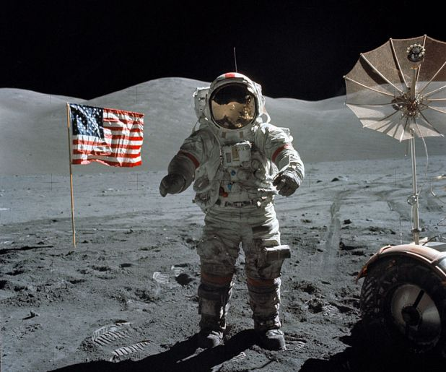
Systems Thinkers …
See the whole picture
See the forest and the trees
View from different perspectives
Look for interdependencies
Understand different models
Think long term
“Go wide” in thinking about cause and effect relationships
Think about potential benefits (opportunities) as well as about unintended consequences (risks)
Focus on problem solving, not finding blame
With thanks from: Astronomy Picture of the Day; Apollo 17: Last on the Moon Credit: Apollo 17, NASA; scanned by Kipp Teague (http://antwrp.gsfc.nasa.gov/apod/ap021212.html)
Systems Thinking Playbook, Sweeney and Meadows; 1995
Notes:
9903
Explanation: In December of 1972, Apollo 17 astronauts Eugene Cernan and Harrison Schmitt spent about 75 hours on the Moon, in the Taurus-Littrow valley, while colleague Ronald Evans orbited overhead. Near the beginning of their third and final excursion across the lunar surface, Schmitt took this picture of Cernan flanked by an American flag and their lunar rover's umbrella-shaped high-gain antenna. The prominent Sculptured Hills lie in the background while Schmitt's reflection can just be made out in Cernan's helmet. The Apollo 17 crew returned with 110 kilograms of rock and soil samples, more than from any of the other lunar landing sites. And after thirty years, Cernan and Schmitt are still the last to walk on the Moon.

Slide 9
Interview with NASA Administrator, M. Griffin on
“The True Challenge of Project Management”
Dr. Griffin continued that systems engineering and project management are opposite sides of the same coin. To talk about one without the other is flawed. The losses of Challenger and Columbia, the Hubble Space Telescope’s flawed optics, Mars Observer, Mars Climatology Observer ‘99, Mars Polar Lander, Genesis - all of these programs’ issues were due to failures in program management and systems engineering. They all must be looked at as learning experiences, to learn as much from them as possible so we can repeat as few of them as possible.
So how do we teach the big picture concept? If all agree that the ability to operate at the big picture level is really important, how do we teach it? Dr. Griffin said we can identify the trait, see it in certain young engineers. If we conclude that it is a skill you can’t teach, look for those who have it and use them. I am reminded of the idea that you can learn to play the piano, but if you don’t have the innate skill it will always be forced, not natural. We need to play to our strengths and play up other’s strengths as well. It wasn’t so long ago that systems engineering wasn’t even considered a formal discipline. Today, there is a body of knowledge devoted to systems engineering and program management. They have been formalized and can be taught. You may not be able to teach how to see the big picture, but you can teach the tools and skills to people to facilitate seeing it.
Dr. Griffin identified several things that are disquieting or in his words “scary” with respect to systems engineering and program management. Sometimes there is a failure to understand the systems engineering is the final gate of “the general ship of engineering.” If the lead systems engineer misses something, odds are that the program manager is not going to catch it, nor should it be his job to do so. Systems engineering cannot be only a set of tools and processes for ensuring that all the system interface requirements are met. They are components of it, but to lose sight of the big picture is a failure of systems engineering. Systems engineering is about asking the right questions, not so much having the answers to all the questions. It is about minimizing the unintended consequences of a design.
Notes:
Affiliated Reading:
Mike Griffin’s Boeing Lecture at Purdue University: System Engineering and the “Two Cultures” of Engineering

Slide 10
The Need for Systems Thinking
“Problems cannot be solved by the same level of thinking that created them.” Albert Einstein
Notes:
9903
Notes

Slide 11
Back-up
Note: Depending on how much time is spent on the course overview information, including the syllabus and schedule, more slides and discussion can be added on the general topic of systems thinking. There are a number of slides included in the back-up that can be pulled forward into the body of the lecture.

Slide 12
Characteristics of Engineers with High Capacity for Systems Thinking
Rank | Characteristic | Questionnaire N= 276 | Interviews
 |  | Score (1-5 scale) | Frequency | % (of 77)
1 | Understanding the whole system and seeing the big picture | 4.23 | 62 | 81
2 | Understanding interconnections; closed loop thinking | 4.22 | 43 | 56
3 | Understanding system synergy | 4.32 | 34 | 44
4 | Understanding the system from multiple perspectives | 4.26 | 26 | 34
5 | Think creatively | 4.24 | 24 | 31
6 | Understanding systems without getting stuck on details; tolerances for ambiguity and uncertainty | 4.25 | 22 | 29
7 | Understanding the implications of proposed change | 3.85 | 14 | 18
8 | Understanding a new system/concept immediately upon presentation | 3.74 | 12 | 16
9 | Understanding analogies and parallelism between systems |  | 9 | 12
10 | Understanding limits to growth |  | 8 | 10
Ref: “Knowledge, Abilities, Cognitive Characteristics and Behavior Competencies of Engineers with High Capacity for Engineering Systems Thinking”, Moti Frank, Systems Engineering, Volume 9, Number 2, Summer 2006
Notes:
9903
Notes:
*Synergy or synergism (from the Greek synergos meaning working together, circa 1660) refers to the phenomenon in which two or more discrete influences or agents acting together create an effect greater than that predicted by knowing only the separate effects of the individual agents.
The data above comes from 2 different studies: one was a questionnaire, the other were results of specific interviews.

Slide 13

Systems Thinking – Why is it Important?
“Problems cannot be solved by the same level of thinking that created them.”
Albert Einstein
To comprehend and manage the requirements, and to develop the solution, we have to understand how it fits into the larger system of which it is a part.
Environment
Regulations
Impacts
Customers
Authorities
System
Life Cycle (Disposal)
When our response to opportunities and challenges is fragmented,
the results are often insufficient or short sighted.
Notes:
9903
Notes

Slide 14
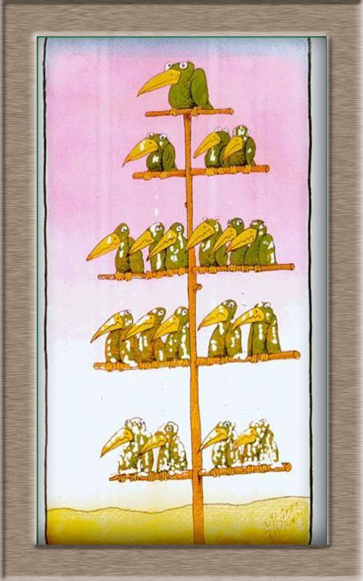
Systems Thinking – Hierarchy
Why is it Important?
“Never forget that the system being addressed by one group of engineers is the subsystem of another group and the super-system of yet a third group.”*
* Dennis M. Buede, The Engineering Design of Systems, 2000, John Wiley & Sons.
As systems engineers we must consider products above, peer products, and subordinate products.
Notes:
9903

Slide 15
Include an example for systems thinking…
What is the system? Can always use the Shuttle.

Slide 16
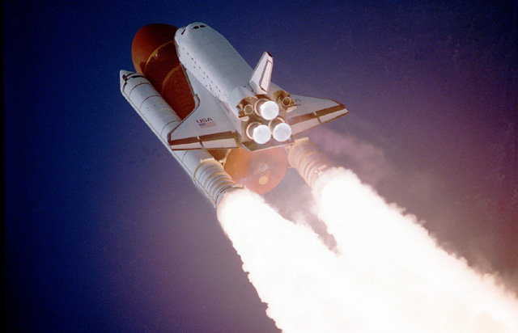
Systems Thinking Example
Think of the Space Shuttle, I.e., the Space Transportation System (STS)…how would you define the system?

Slide 17
Hierarchical Relationships for Systems of Interest
Program
System of Interest
Project
Project
System of Interest
System of Interest
Subsystem
Subsystem
Assembly
Assembly

Slide 18
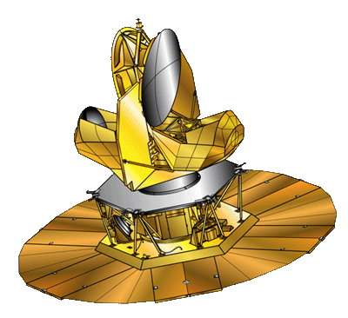

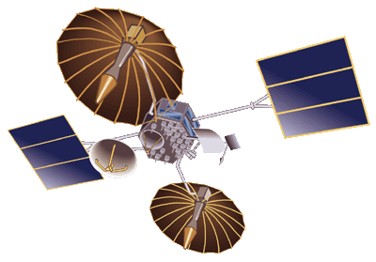
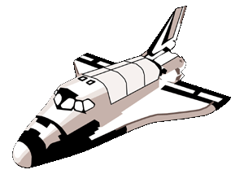
Enabling Systems, or together can be thought of as a System of Systems
A Satellite with Three Enabling Systems
GPS Enabling System
Satellite of Interest
TDRSS Enabling System
Launch Vehicle Enabling System

Slide 19
Hierarchical Relationships for Enabling Systems
Program
System of Interest
Enabling Systems
Project
Project
System of Interest
Enabling Systems
System of Interest
Subsystem
Subsystem
Enabling Systems
Assembly
Assembly
Systems engineering focus must include all aspects of the environment in which the system of interest operates.

Slide 20

What Does “Systems Thinking” Involve?
  Understanding the system requirements regardless of the position of one’s product in the system decomposition hierarchy
  Assessing the impact of system requirements on the subsystem for which one is responsible
  Assessing the impact of subsystem constraints on the system
  Assessing the impact of the subsystem’s requirements on lower level products before selecting a subsystem concept
Notes:
9903

Slide 21
Techniques That Promote Systems Thinking
Early determination of the
customer validation approach
often clarifies requirements. Verification
planning at concept development often eliminates flawed concepts that lead to failure.
Validation Planning and
Solution Requirements
Concurrent product and process development where all phases of the product life cycle and all stakeholders need to be considered at the outset and throughout the project cycle.
USER
Manual
Concurrent Engineering
Ensure all needs are considered through stakeholder involvement, identification of alternate solutions and rigorous analysis to define the best solution .
Discovery and Analysis
Notes:
9903

